Slide 1



THE MATRIX
CME1251 Project Based Learning - I
by
2019510025 Cemil dalar
2019510108 oğuz kaan şanlı
2020510026 Mustafa efe demir
IZMIR

Slide 2
INTRODUCTION
First of all for this project the goal is taking matrix input from the user and calculating some terms, determining the entered matrix types and solving the equation with 3 unknowns with gauss elimination method.
We tried to understand what we need for this project.

Slide 3
PROGRESS SUMMARY

Slide 4
Requirements
TEAM SPIRIT
KNOWLEDGE ABOUT MATRIX
NEED TO KNOW GAUSS ELIMINATION METHOD
BASIC PROGRAMMING KNOWLEDGE

Slide 5
Task Sharing / Completed Tasks
MUSTAFA EFE DEMIR OĞUZ KAAN ŞANLI CEMİL DALAR
OPERATION A OPERATION A OPERATION A
-ENTER A MATRIX(INPUT SYSTEM) -CALCULATE SUM OF COLUMNS -CALCULATE TRANSPOSE OF MATRIX
-CALCULATE SUM OF ROWS -CALCULATE SUM OF PRIMARY DIAGONAL -CALCULATE DETERMINANT OF THE MATRIX
OPERATION B OPERATION B OPERATION B
-DETERMINE MATRIX TYPE -DETERMINE MATRIX TYPE -DETERMINE MATRIX TYPE
(IDENTITY MATRIX) (DIAGONAL MATRIX) (SYMMETRIC MATRIX)
(SCALAR MATRIX) (ZERO-ONE MATRIX) (PERMUTATION MATRIX)
OPERATION C OPERATION C OPERATION D
-CALCULATE MIN VALUES OF EACH ROW -CALCULATE MINIMUM OF MAXIMUM -GAUSS ELIMINATION METHOD
-CALCULATE MAX VALUES OF EACH COLUMN VALUES OF EACH COLUMN -CONVERT TO MATRIX TO ROW ECHELON
-CALCULATE MAXIMUM OF MINIMUM -COMPARE TO MAX TO MIN -CALCULATE THE VALUE OF UNKNOWNS
VALUES OF EACH ROW (MAXMIN)

Slide 6
Incomplete Tasks: Reasons, Explanations
ALL DONE!

Slide 7
Additional Improvements
We used colored codelines for good view.
We used String.Format for looking organized.
We used Math.Round for looking organized.
We did flowcharts.

Slide 8
PROBLEMS ENCOUNTERED
Decimal numbers were looking bad on the console.
When a1 was zero, there were a lot of errors dividing by zero in the console.
In some operations performed in if statements, the same results started to appeared, because no other variable was assigned that was completely independent of the operations.
2 unknown 3 equations formed by entering a1,a2 and a3 zeros on the user side could not be solved with 3*4 matrices.
Operation d operations, which we previously performed in 4 steps, were not enough to solve many equations.

Slide 9
ALGORITHMS AND SOLUTION STRATEGIES
Think:
Analyze the problem
Restate the problem
Write out examples of input and output
Break the problem into its component parts
We discussed how to convert samples to code
Execute:
Code it up
Step through our example data with our code Test your solution against our examples
Find the errors

Slide 10
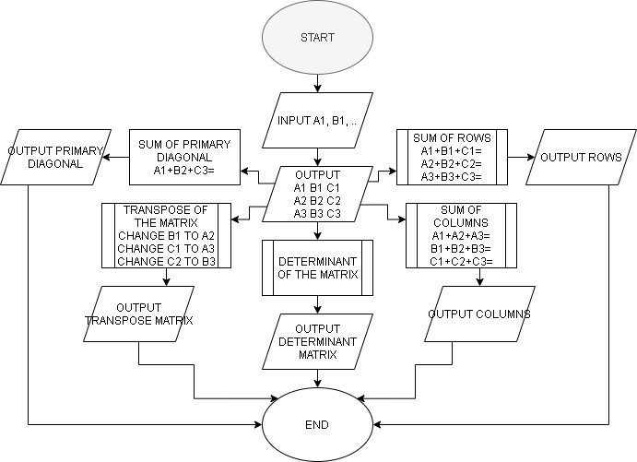
OPERATION A’S FLOWCHART

Slide 11
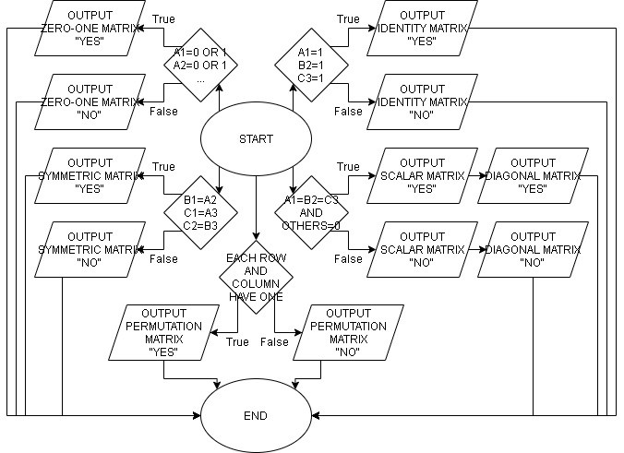
OPERATION B’S FLOWCHART

Slide 12
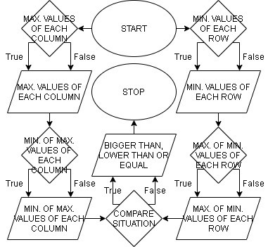
OPERATION C’S FLOWCHART

Slide 13
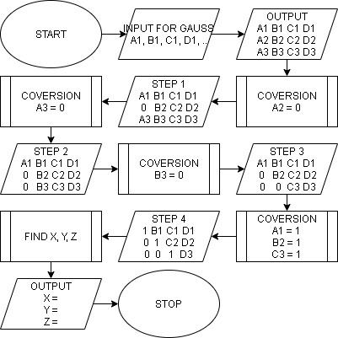
OPERATION D’S FLOWCHART

Slide 14
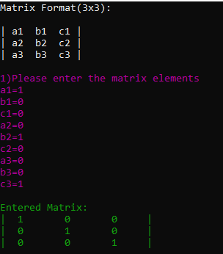
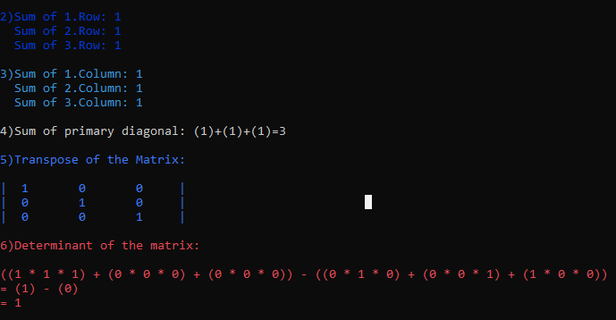
SCREENSHOTS
OPERATION A

Slide 15
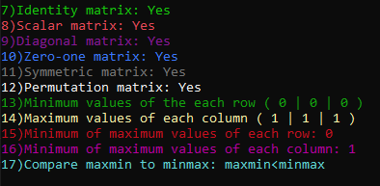
SCREENSHOT
OPERATION B / C

Slide 16
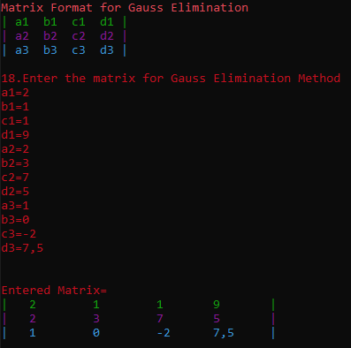
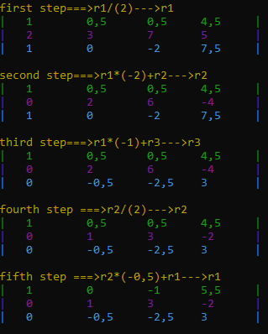
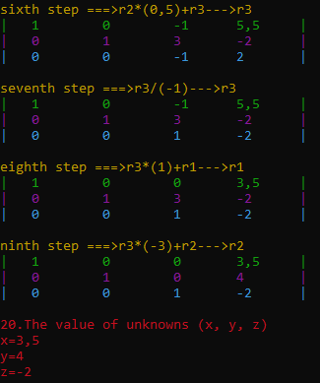
SCREENSHOTS
OPERATION D

Slide 17
REFERENCES
CME 1211 ALGORITHMS AND PROGRAMMING RESOURCES
https://stackoverflow.com
https://www.youtube.com/watch?v=eDb6iugi6Uk
https://docs.microsoft.com/tr-tr/dotnet/csharp/
https://www.youtube.com/watch?v=01CFumW2FBY

Slide 18
conclusıon
As a result, in this project, we learned about the task sharing, the responsibilities we should take, how to solve the problems that came up, how to solve the mistakes by discussing with our group friends, to search for the solution of the problems requested from us, to add new things, and how to present the problems to any person or people in any place with the solution.

Slide 19
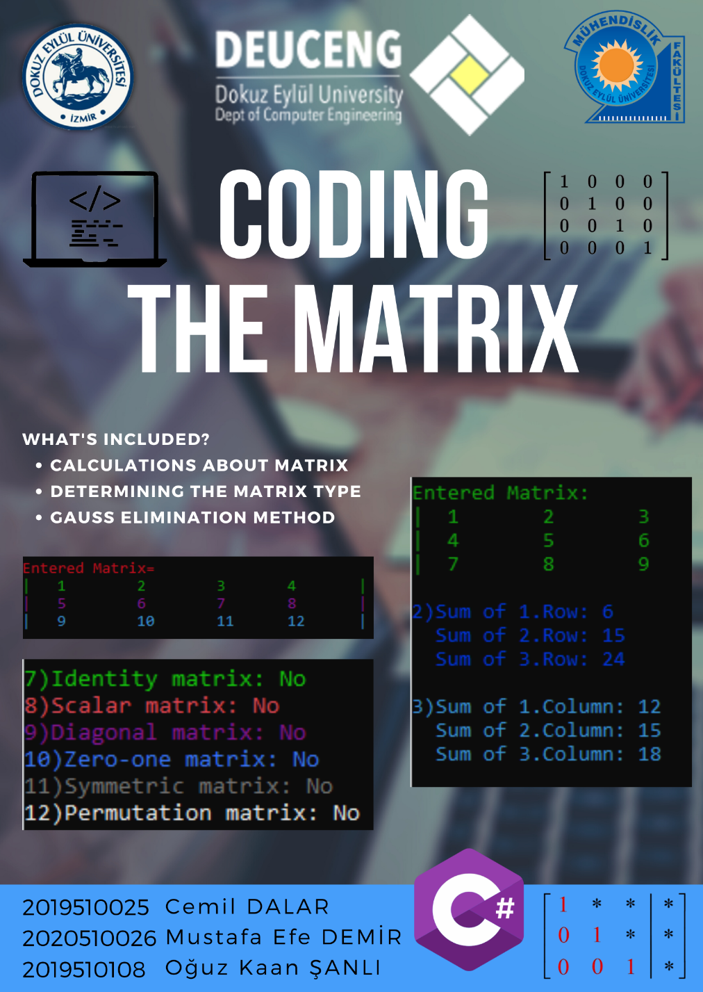
OUR POSTER

